Slide 1
Model Comparison in
Stock Forecasting
Members: Ali Al-Jabri, Boyuan Tao, Jose Gabriel Castillo, Kaiwen Chen, Tao Wang, Yutian Yao, Zilu Yu

Slide 2
Outline
Data Introduction
Autoregressive Integrated Moving Average Model (ARIMA)
Neural Network: Support Vector Machine (SVM)
Generalized Autoregressive Conditional Heterocedasticity Model (GARCH)
Result Comparison
Conclusion

Slide 3
Motivation
Good prediction of return brings low risk to help stockholders.
The accuracy of different models may vary, so we prefer to perform different models.
The accuracy may loss more of a non-linear model applied than linear one.
ARIMA and GARCH model are traditional time series methods to forecast stock return, and we suppose the SVM analysis may outperform them.

Slide 4
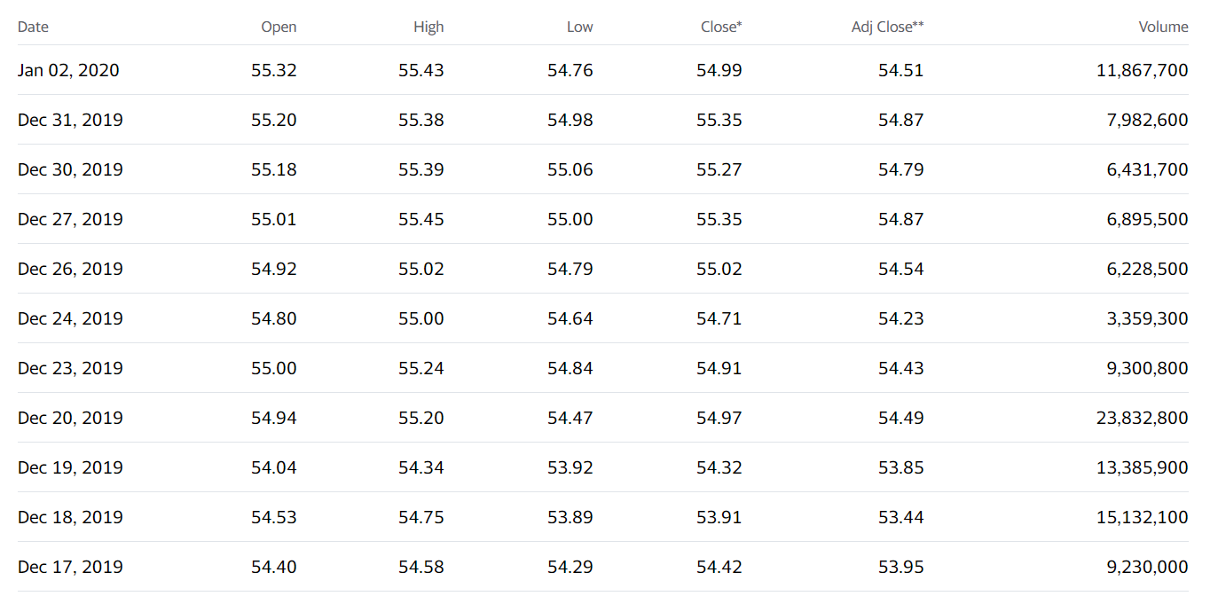
Data
We gathered data of Coca-Cola’s (NYSE: KO) stock prices in the period of 01/01/2016 to 01/01/2020 from Yahoo Finance

Slide 5
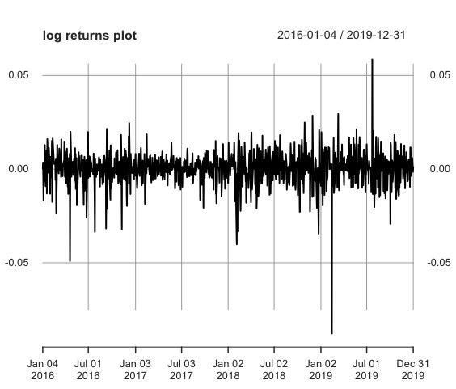
ARIMA Model
Transformed them into daily log returns

Slide 6
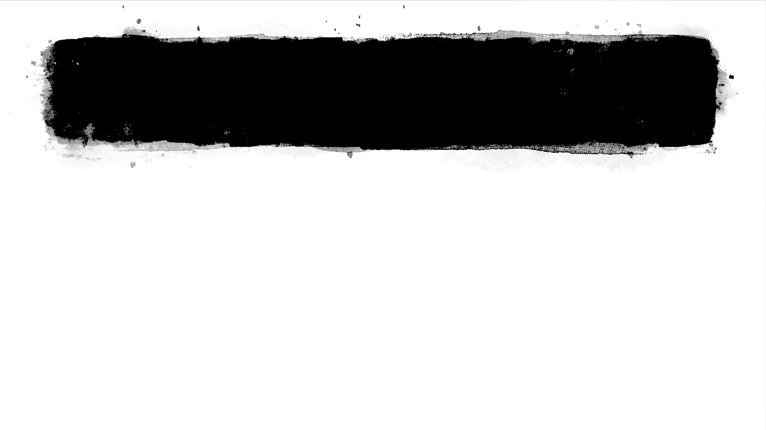
ARIMA Model Process
ADF test
To check if the series is stationary and ready to be modeled
Splitting Dataset
To create a training set for 976 days and a testing set for 30 days
Auto.arima Function
We used the auto.arima function in R to choose the best parameters for the ARIMA model
ACF and PACF plots
To check the selection of parameters
ARIMA(2, 0, 4)

Slide 7
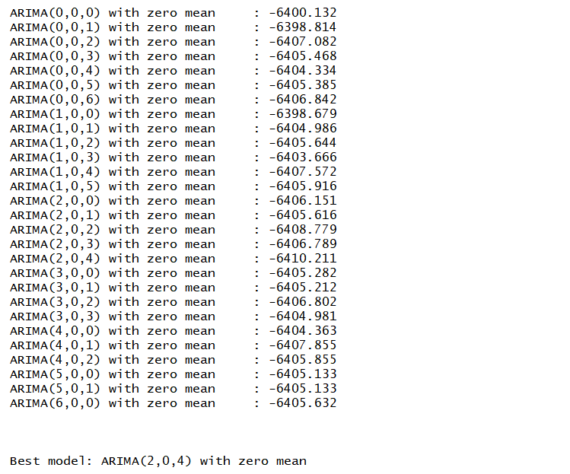
Auto.arima
ARIMA(2, 0, 4) is the best one based on AIC criteria

Slide 8
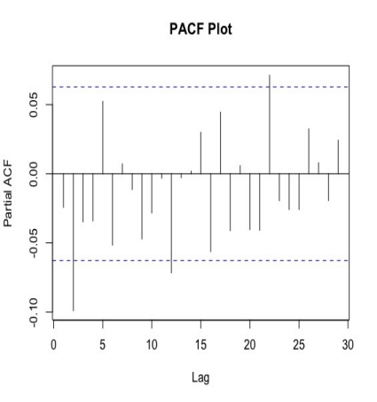
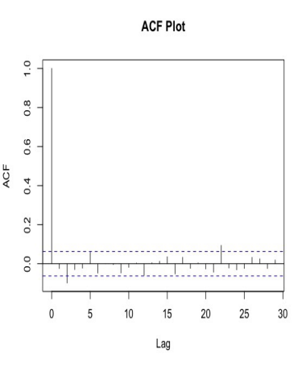
ACF and PACF Plots
we applied the ACF and PACF function to the training set of data to check the selection of parameters

Slide 9
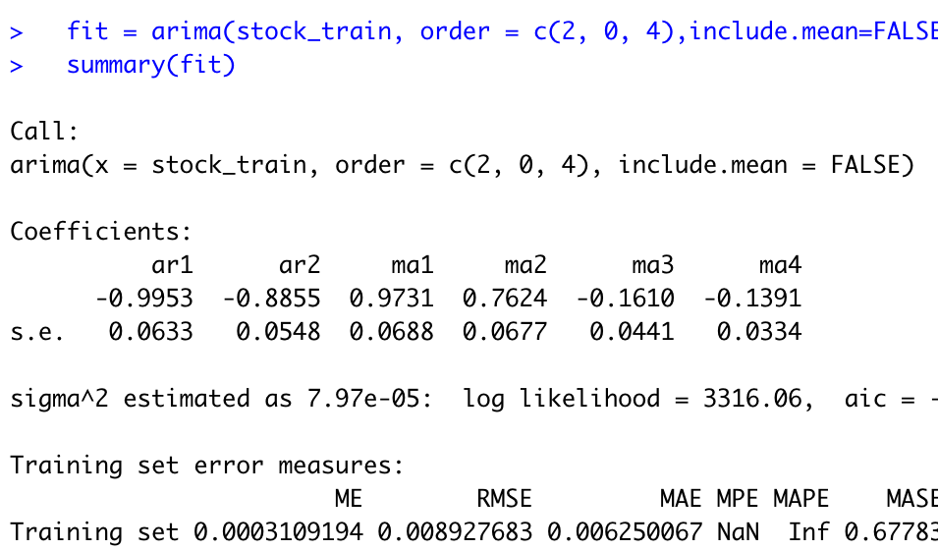
ARIMA(2, 0, 4) Model

Slide 10
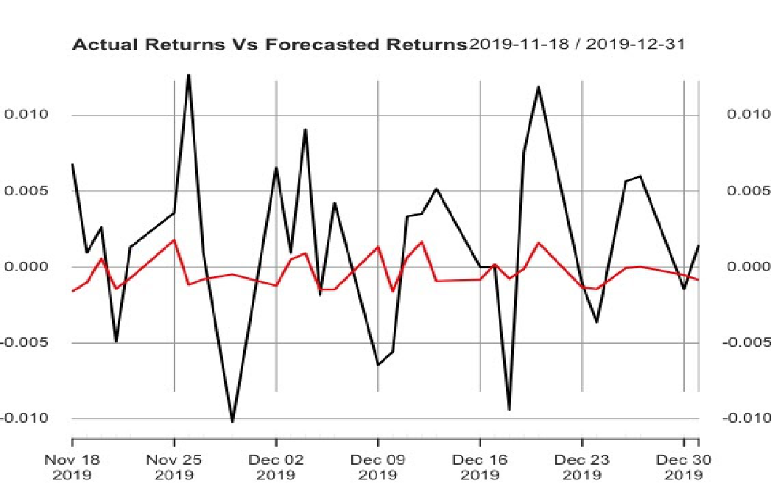
ARIMA Forecast Result
Actual Returns (black line) vs. Forecasted Returns (red line)
Move in the same direction
53.33% accuracy of this model

Slide 11
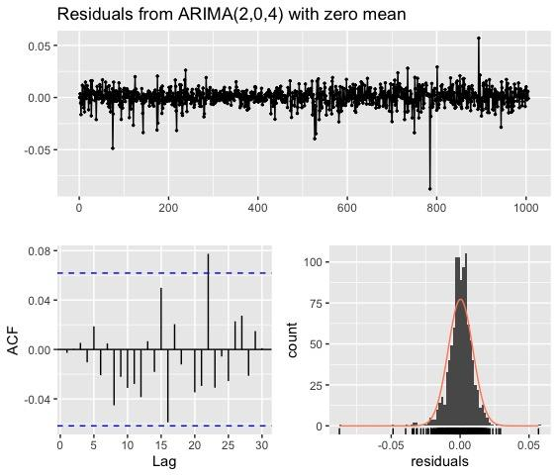
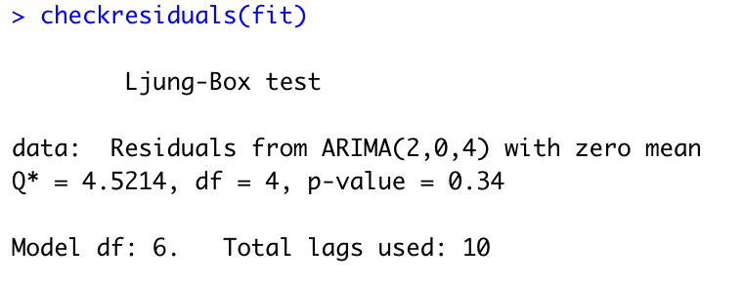
Diagnostics of Our Model
Goal:
Residuals have zero mean and no obvious correlation.
✓Satisfied:
Plots
Residuals behave like white noise
Ljung-Box test
Large p-value

Slide 12
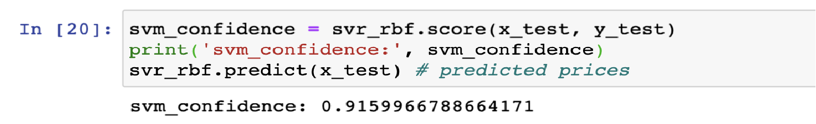
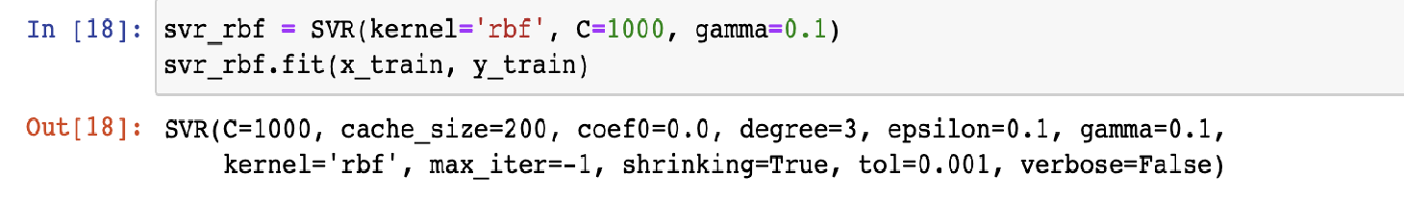
Support Vector Machines (SVM)
Employ Support Vector Regression (SVR)
For SVM, daily stock price is more suitable.
We used radial basis function when building SVR
fitted our testing data to the model and obtained the prediction of stock prices

Slide 13
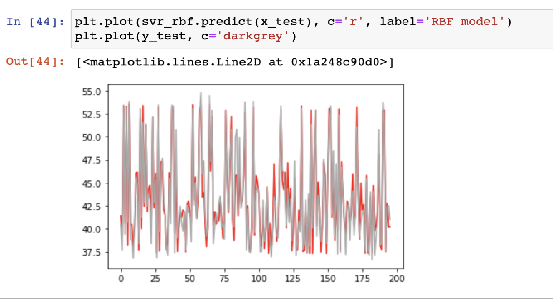
SVM Forecast Results
Actual Stock Price (grey line) vs. Forecasted Stock Price (red line)
Largely overlapped
Showing a relatively high level of accuracy

Slide 14
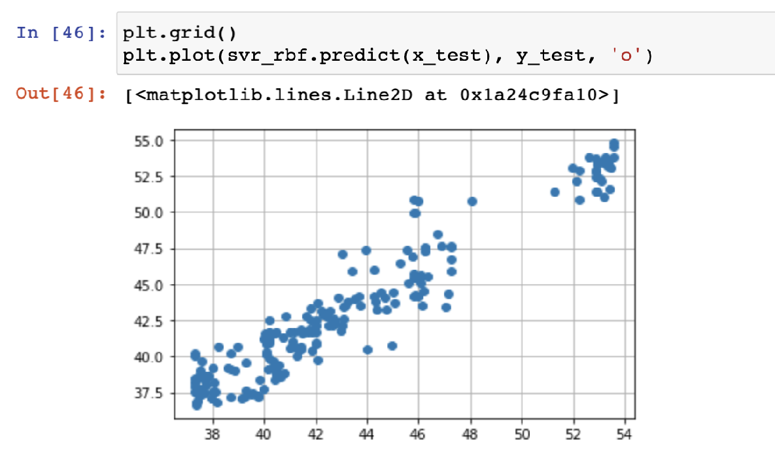
SVM Forecast Results
Correlation between predicted prices and actual prices
Strong positive correlation
0.9571

Slide 15
GARCH Model
GARCH model assumes an ARMA model for the variance of time series.
Another model is required for the mean of time series. (ARMA here)
data~ARMA(p,q)+GARCH(p’,q’)
use garchFit in fGARCH (R)

Slide 16
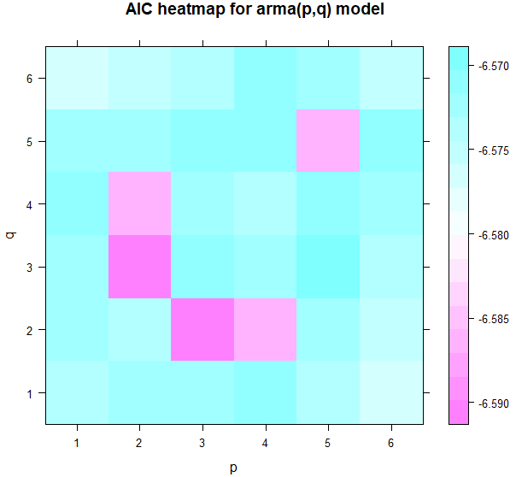
GARCH Model--ARMA
Choose ARMA(p,q) with minnimum AIC
ARMA(2,3)
AIC = -6.589924

Slide 17
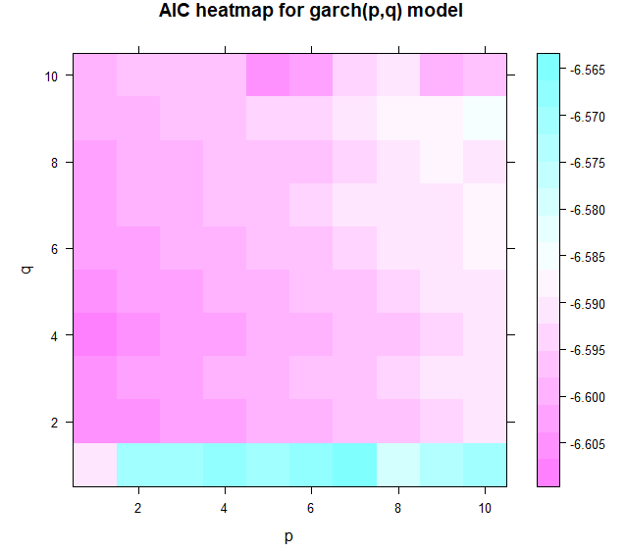
GARCH Model--GARCH
Choose ARMA(2,3)+GARCH(p’,q’)
with minnimum AIC
ARMA(2,3)+GARCH(1,4)
AIC = -6.606809

Slide 18
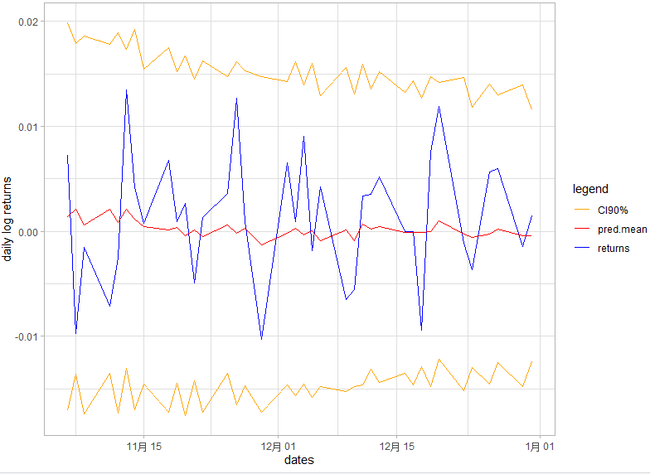
GARCH Model--Prediction
Predict both mean and var on test set.
Confidence Interval (CI) 90%
Predicted Mean
Actual Returns
Mean Prediction Accuracy 52.63%

Slide 19
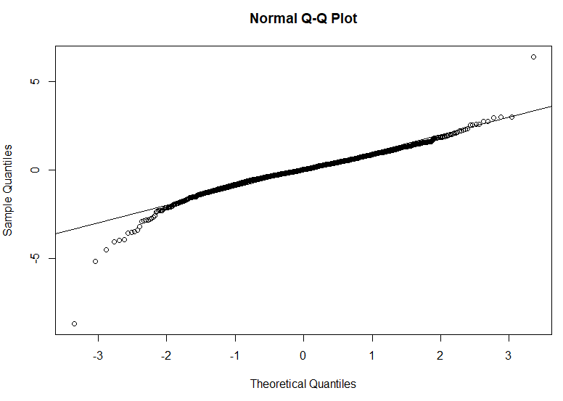
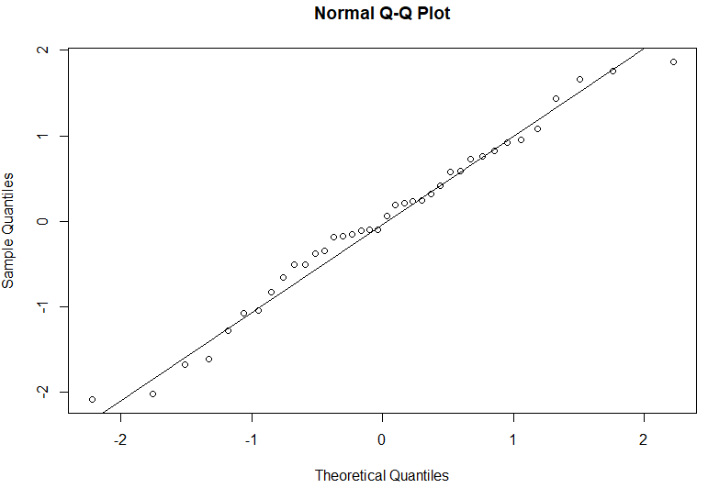
GARCH Model--Residuals
Train Set
Test Set

Slide 20
Comparison and Conclusion
Support Vector Machines (SVM) works perfect for stock return forecasting.
ARIMA Model and GARCH Model are better to predict the stock price than stock return.
Although the fluctuation of price is not as large as the actual price in ARIMA model, the direction and the trend are approximately matching, so it may also be a good model for stockholder to make trade decision.
 | ARIMA Prototypical | Support Vector Machines (SVM) | Garch Model
Accuracy | 53.33% | High level of accuracy | 52.64%

Slide 21
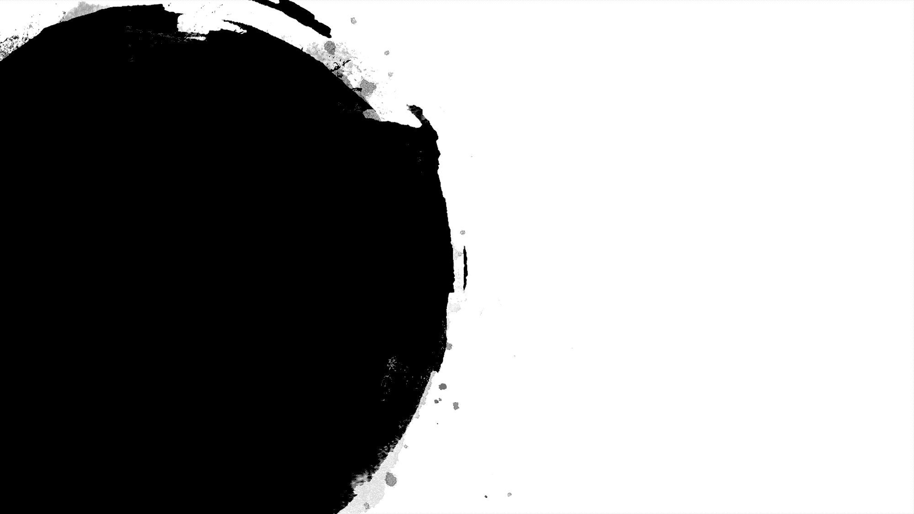

Thank you！

